Slide 1
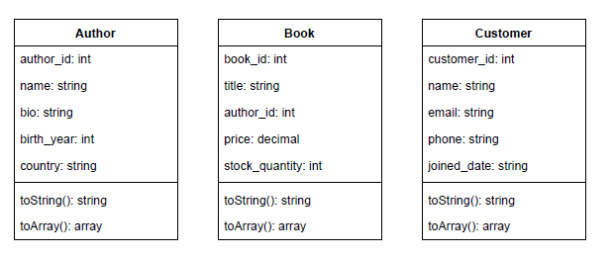
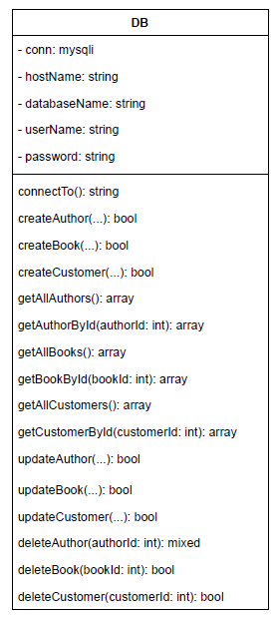
UML Diagram overview
Designed UML diagrams for core entities: Author, Book, Customer, and DB.
DB class manages all database interaction (CRUD methods).
Entity classes hold data structure; DB class performs logic.
Relationships between entities (e.g., Book to Author) are implied, not enforced with foreign keys.

Slide 2
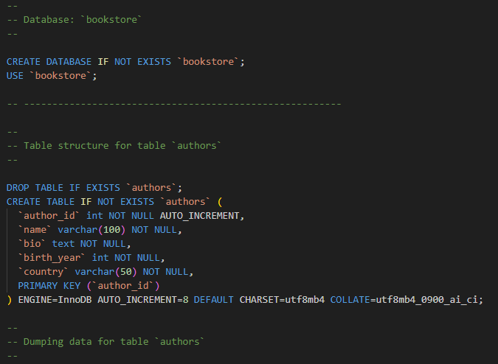
Database schema setup: sql database structure
bookstore.sql defines and sets up three core tables: authors, books, and customers.
Each table has an AUTO_INCREMENT primary key for unique identification.
Foreign keys (e.g. author_id in books) were considered, but intentionally left out.
This decision allowed for easier individual table testing during development.

Slide 3
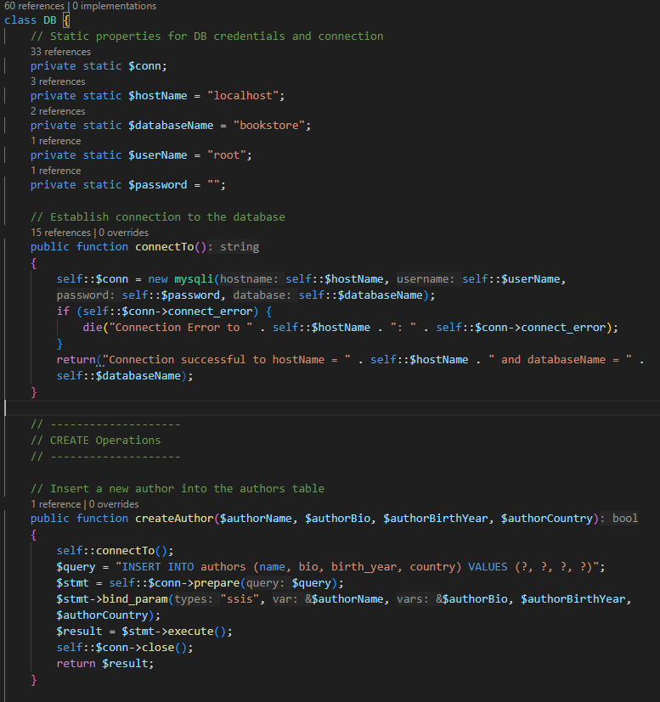
DB.php Class: database connection & query handling
DB.php is the main controller for all database interactions in the backend.
Establishes a secure connection to MySQL using mysqli and prepared statements.
Contains dedicated CRUD functions for each entity: createAuthor(), updateBook(), deleteCustomer(), etc.
Designed to separate logic from structure, allowing the Author, Book, and Customer classes to remain lightweight data containers.
All DB logic is centralized to improve modularity and simplify future updates (e.g., adding JOINs or foreign key logic).

Slide 4
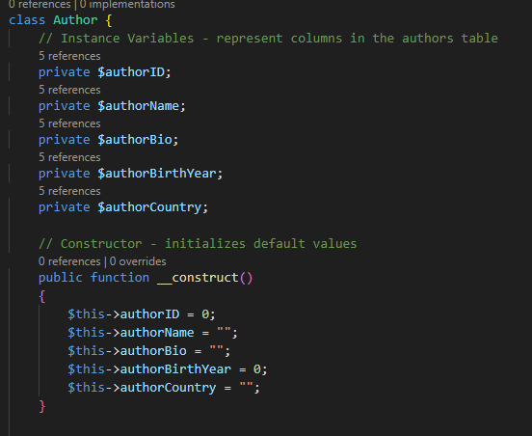
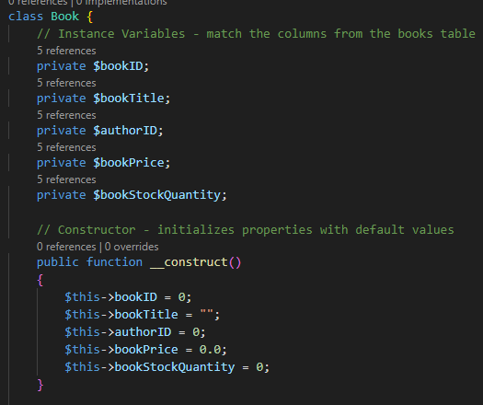
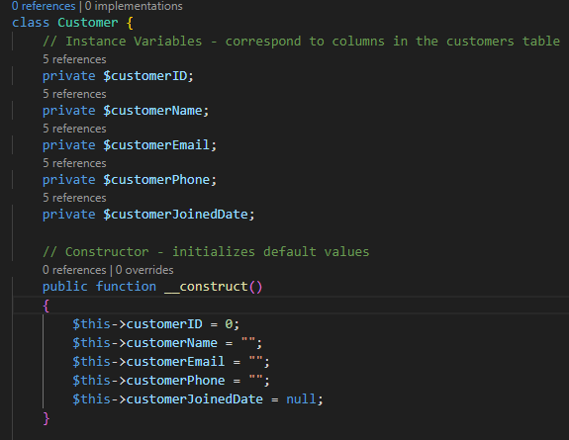
Author, book, and customer classes: class structure and responsibilities
Each class (Author.php, Book.php, Customer.php) models a single entity from the database.
Contains private properties that map directly to columns in the database table.
Each class includes a constructor to initialize default values for cleaner object creation.
These classes are lightweight containers — they don't include logic, just structure.
Designed to work seamlessly with DB.php, which handles all SQL operations.
Promotes separation of concerns between data structure (these classes) and business logic (DB.php).

Slide 5
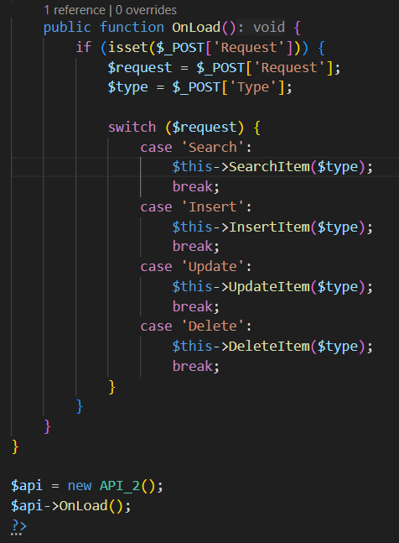
API ONLOAD function
Checks for a $_POST value for request and then checks for the type. From there it calls the matching function: search, insert, update, delete and passes it the type author, book, or customer.
OnLoad is called when the API is accessed by the frontend.

Slide 6
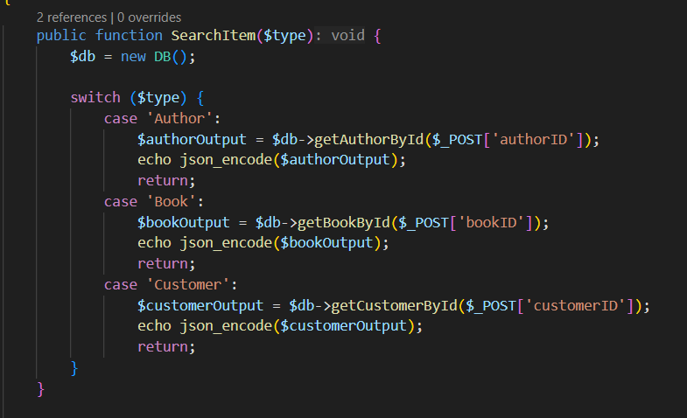
API SEARCH FUNCTION
Checks the $type input and switches between the three databases. Then it searches them for the matching ID sent over by the $_POST request.

Slide 7
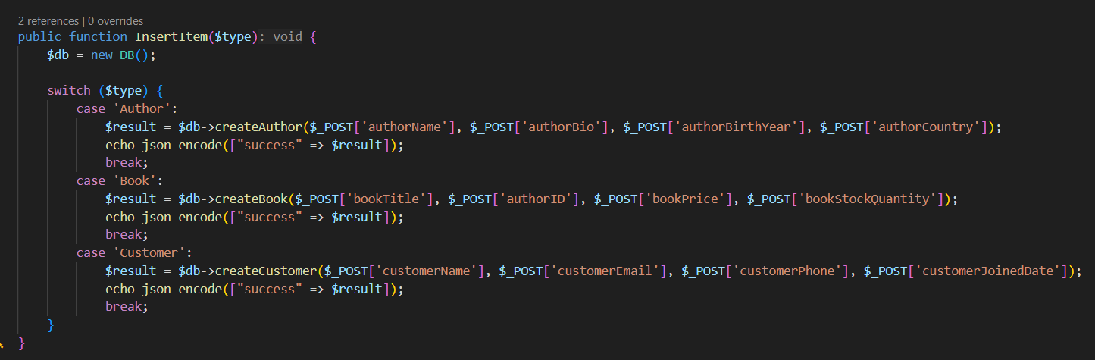
API INSERT FUNCTION
Checks the $type input and switches between the three databases. Then it checks the $_POST request for the matching fields and inserts them into the table. Then it echos the result to confirm an item was inserted.

Slide 8
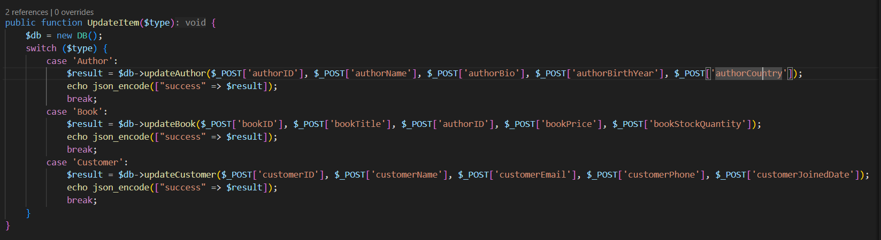
API Update function
Checks the $type input and switches between the three databases. Then it calls the matching update function alongside the values from the $_POST request to update the table.

Slide 9
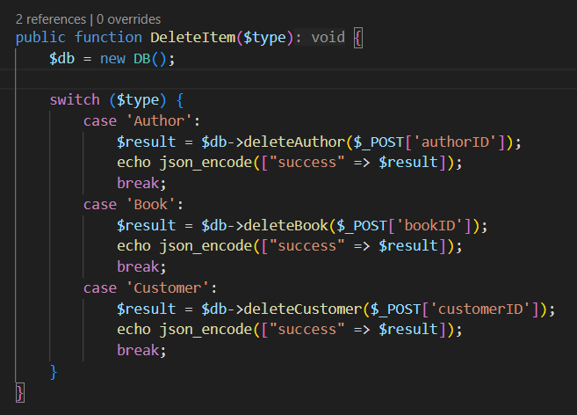
API Delete function
Checks the $type input and switches between the three databases. Then it runs the matching delete function using the ID gained from the $_POST request.

Slide 10
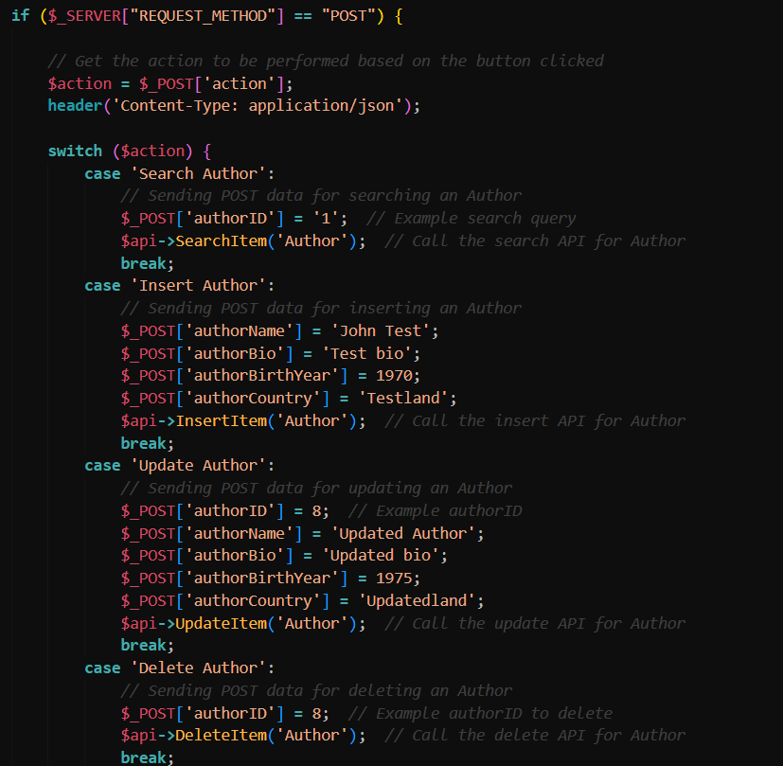
Test_api.php
The test_api.php file is designed to have predetermined data to test the connectivity of the API
A switch statement is used in order to have the different CRUD operations be implemented when the user clicks a button on the page.

Slide 11
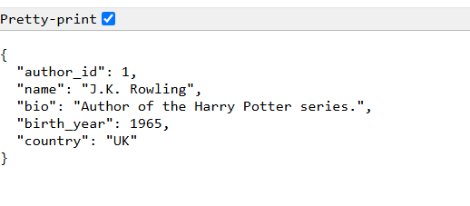
After testing search function of api

Slide 12
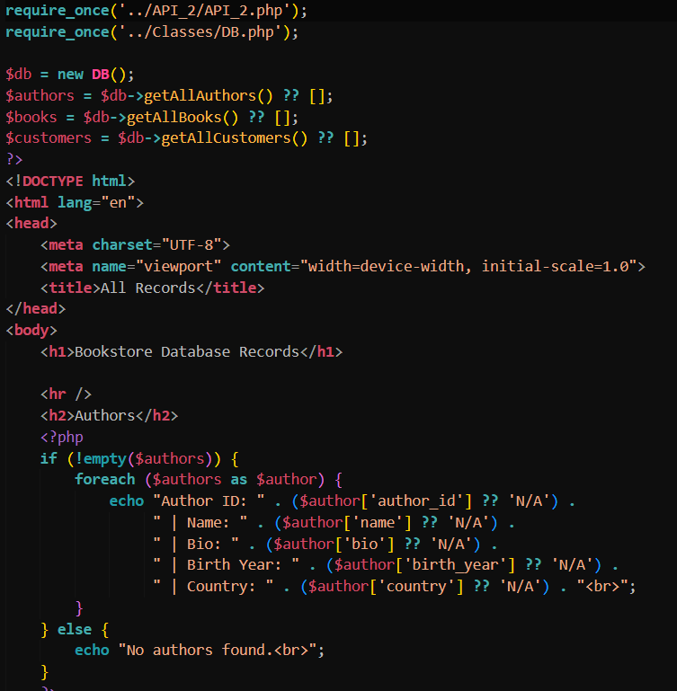
Display_records.php
The display_records.php file is designed to get all of the values from all of the tables and put it into simple html in order to verify the connectivity of the database.
A database object is created, then the getAll functions are used for the authors, books and customers variables.
Then a foreach loop is utilized to display all of the rows for each table.

Slide 13
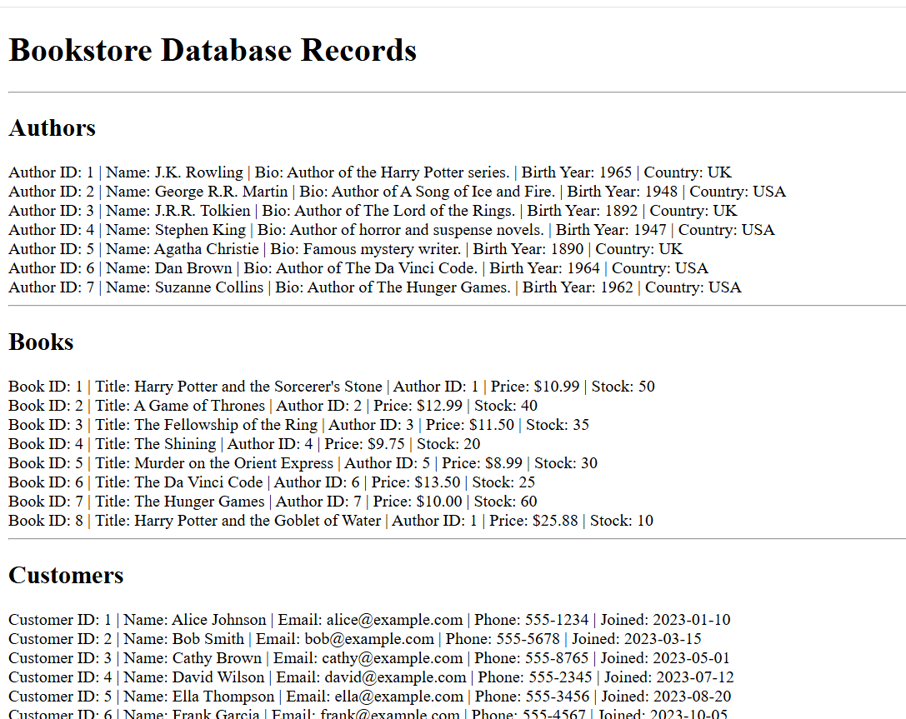
All records displayed

Slide 14
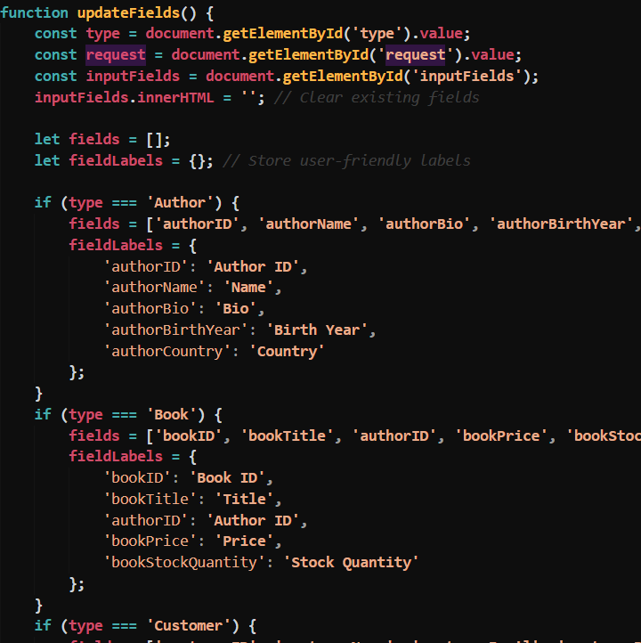
Index.html
The home page, which acts as an API web client, has a dynamically changing form based on which option the user selects (author, book or customer).
The attached code snippet shows the updateFields() function which utilizes JavaScript to change the form based on which option is selected in the dropdown

Slide 15
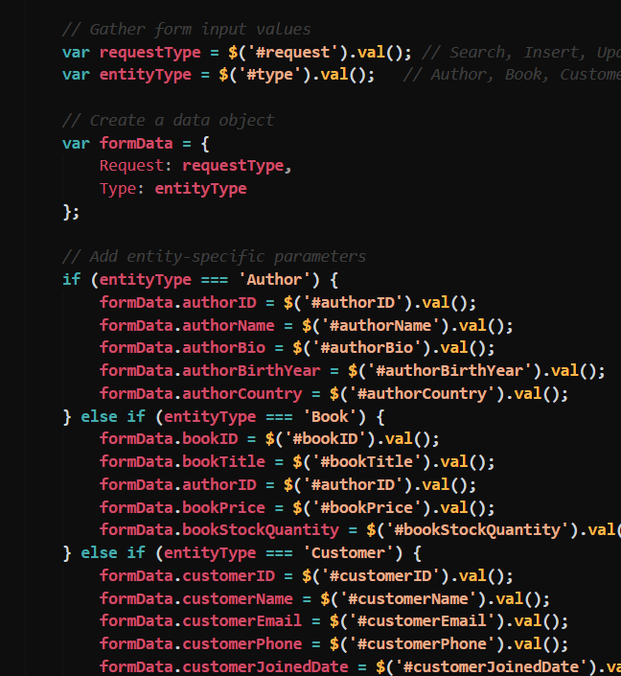
Index.html
The following code snippet shows how the specific request type for a CRUD function and for which table are set to the variables needed for those functions to run.
Based on which entity is selected, the formData prepares the values for the AJAX request to send to the API to perform the various CRUD operations.

Slide 16
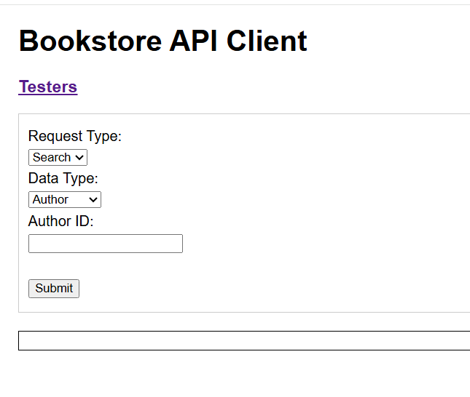
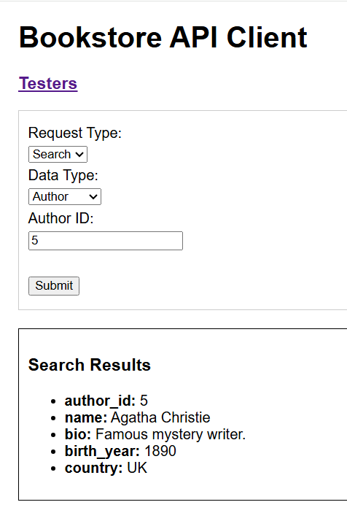
Before and After Searching Database

Slide 17
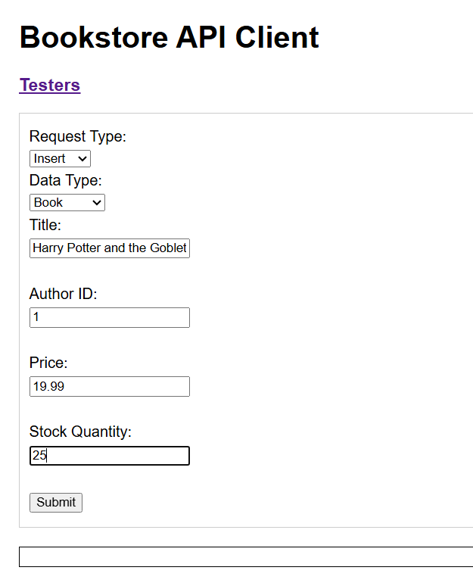
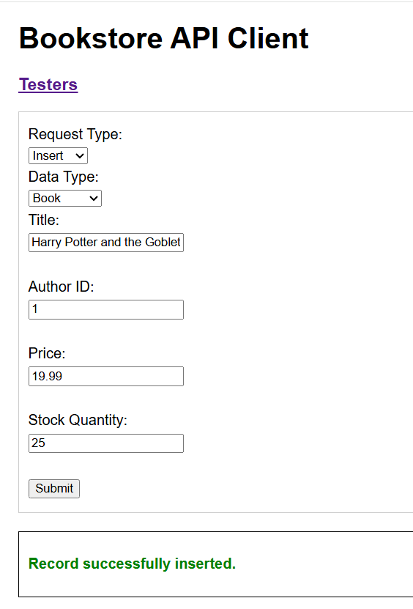
Before and After Inserting Record

Slide 18
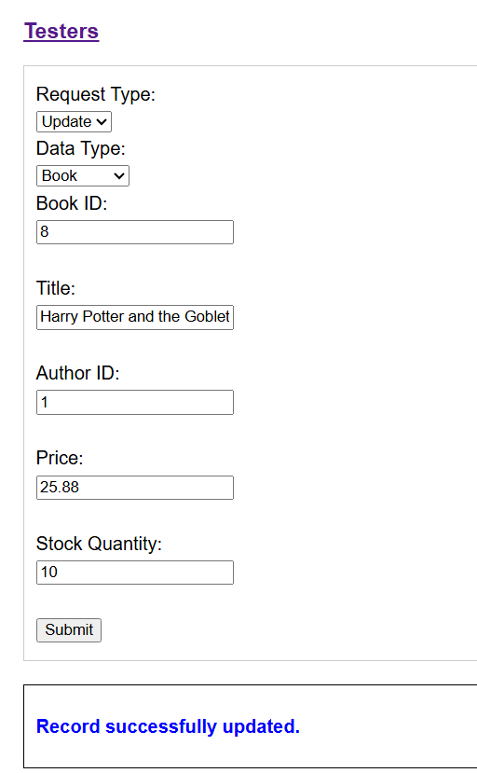
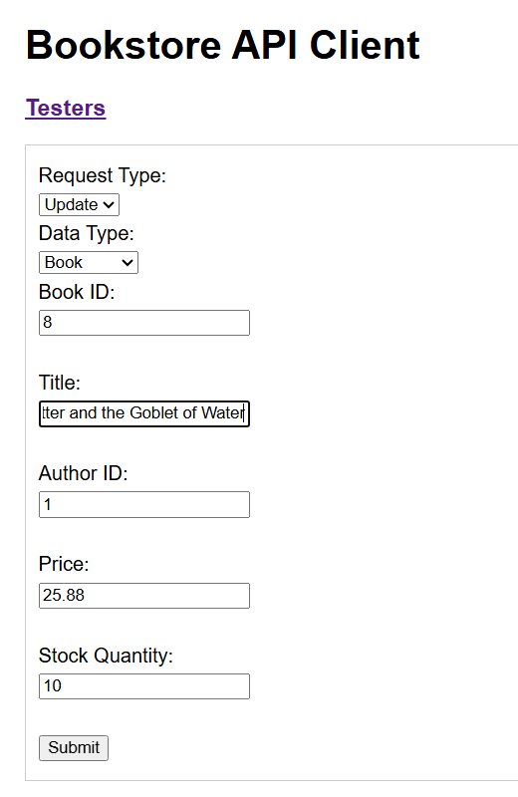
Before and After Updating Record

Slide 19
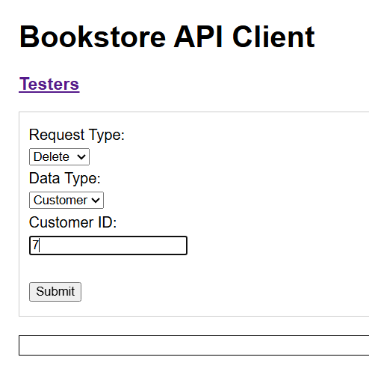
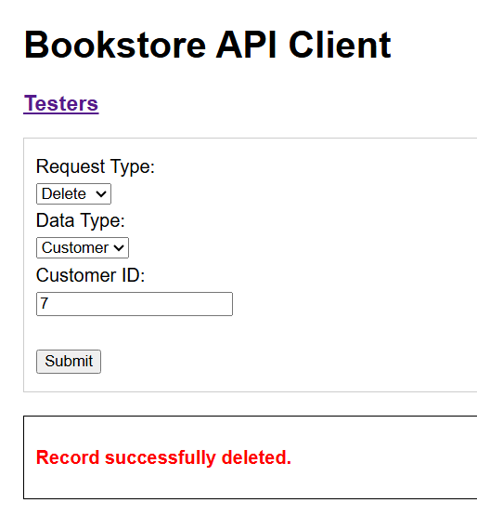
Before and After Deleting Record

